Slide 1
IE260 Lecture 7: Binary Tree
Il-Chul Moon
Department of Industrial and Systems Engineering
KAIST
icmoon@kaist.ac.kr

Slide 2
Short Recap

Slide 3
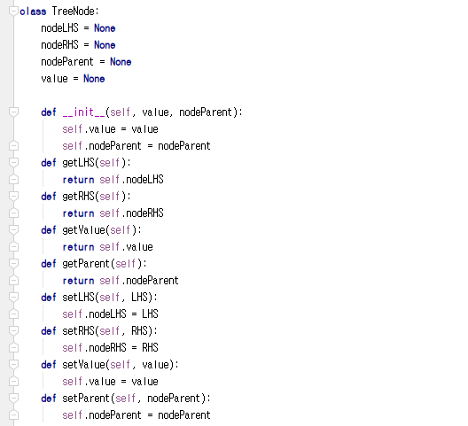
Implementation of Tree Node
Has three references
Left hand side (LHS)
Right hand side (RHS)
Its own value
Its parent node
Not implemented here, but
LHS stores
Values have lower than its own value
RHS stores
Values have higher than its own value
Just as we all know that the department stores do not have a restroom on the first floor
Other than four references,
Simple get/set methods
What are the get/set methods?
Coming from encapsulation
Four references
Notes:
To better understand the concept of a binary search tree, let’s consider its use in actual implementation.
First off, we need the nodes of a tree to construct a tree.
Suppose that there is a pointer directed to the reference of the parent in this node.
We would assume that we have the left and right here, along with the value pointing at values.
Thus, we will define a tree node with four references.
The four references point to the left-hand side (LHS), right hand side (RHS), its own value, and the parent.
Let’s say that the LHS always has a smaller value. RHS always indicates the node that points at a larger value.
Then, we would define a method that could “get” and “set” the references.
This example pretty much covers the simple definition of a tree node.

Slide 4
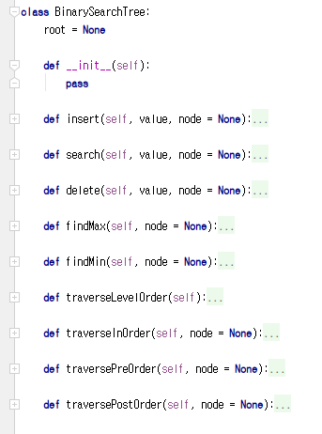
Implementation of BST
Tree instance
A (root)
B
C
D
E
F
BST handles the data stored through its root
Root has its own value
Tree instance access to the root
Only through the root, the tree instances access to the descendant nodes of the root
Notes:
Next, let’s move on and define the binary search tree.
A binary search tree primarily does not store the references of all the tree nodes. It just stores the one for root.
We can carry out operations such as insert, delete, and search by traversing from the root.
For this purpose, we’ve defined various operations including insert, search, delete, findMax, and findMin.
These are implemented by being filled up.
A tree only stores the information of the root.

Slide 5
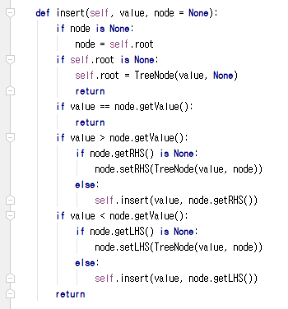
Insert Operation of Binary Search Tree
Insertion operation
Retrieve the current node value
If the value is equal to the value to insert
Return already there!
If the value is smaller than the value to insert
If there is a node in the right hand-side (RHS), then move to the RHS node (Recursion)
If there is no node in RHS, create a RHS node with the value to insert
If the value is larger than the value to insert
If there is a node in the left hand-side (LHS), then move to the LHS node (Recursion)
If there is no node in LHS, create a LHS node with the value to insert
Insert numbers: 3, 2, 0, 5, 7, 4…..
3
2
5
0
4
7
Notes:
Suppose that we are about to conduct “insert” into a binary search tree.
It is necessary for us to consider how to store values while complying with the rules of a binary search tree.
After defining the insert statement like this, you would notice that this is where recursion happens, which we’ve
learned before.
This is the place where you can accommodate the insert operation.
For a recursion to be operated, we need an escape routine.
We’ve found the escape routine here.
As you can see, we can carry out a return in this manner.
When we carry out the insert operation, we first receive a specific node.
If a node is not well-defined, we will get the root instead.
If the root is empty, we can just store a value in that place and return.
If we find that the value contained in the node is already present in the tree, we won’t do an overlapped insert.
Instead, we go for the “return”.
If the numeric value contained in the current node is larger than what will be stored, it should be stored in the LHS
of the node.
Therefore, we attempt to store the RHS of the node. If it’s empty, we can store the RHS in this node.
We can create a tree node and store a node pointing to the RHS in the node
If the node designated by the RHS is not empty, we have to determine which way to go from the node.
However, if we make an insert mode for the RHS’s node, it will be inserted at a reduced size.
In case the same operation is employed for the LHS, if the value is smaller than the one in the current node, it will
proceed with LHS in the same manner.
Let’s see how can we insert these numbers.
This is the process of inserting these numbers without a tree.
First, let’s say we are going to insert the number 3.
Right now, there is nothing in the tree.
Given that there is nothing in the node, we compare it with the root. As the root is left defined, we can define it to
hold the tree node of 3 and return.
So, 3 is stored according to this distinction.
Next, let’s say that we are storing 2.
Given the value of 2, the node will contain a garbage value to make the current node root.
The root isn’t empty, so we will skip the statement.
As the currently held value, 3 is not identical with the value that we intend to insert, 2. That means we can’t carry
out a “return”.
Comparing 2 and 3, as 3 is larger, it will enter the routine.
As the LHS is currently set to a garbage value, it will generate a new node with LHS set in the current node and
store the numeric value, which is 2.
It will do something like this.
Now let’s say we’re going to store 0.
The value turns into 0. The node has a garbage value, so the current node is the root.
As the root is neither empty nor identical, 3 and 0 are compared. The LHS is not empty as 0 is smaller than 3.
Thus, going through the recursion statement, it will produce 0. Then, the node of the LHS with 2 of the current
node that has the value of 3 will be inserted. Then, it will call the “insert” function.
Thus, the node is not a garbage value. 2 and 0 are not identical, so it will descend.
0 is smaller than 2.
As the LHS has a garbage value, we will store 0 there.
Thus, it will be actually stored with the statement. The “return” is actuated to ascend to this statement. Given that
the current node is 3, the function call will also be returned and terminated.
Here, the process of recursion stored 3, 2, and 0.
When 5 comes in, the value will be 5. This node is garbage, so we will skip it. And 3 and 5 are not identical and
5 is greater than 3, so it will be entered here.
As the RHS of the node 3 is empty right now, 5 will be stored with this statement.
Let’s try the same with 7.
As the node has a garbage value, 7, it moves to the lower level. Since it’s not equivalent to 3 again, it comes down.
As 7 is larger than 3 and the RHS is not empty, it will be applied to the recursion to be inserted for 5 here.
The current node will point at 5 with the value of 7. It will be inserted in a small-scale situation.
7 is not identical with 5. It’s larger than 5 with the occupied RHS, so 7 will be entered here for the return. It will
proceed with the recursion up to the return, resulting in 7 being stored.
What would happen to 4?
When 4 is entered, it will be compared to 3. Since 4 is larger than 3, the insert will be handed over to the RHS,
before being compare to 5. As 4 is smaller than 5 with an empty LHS, it will be stored in the LHS. Consequently,
these numeric values will be stored in this binary search tree.

Slide 6
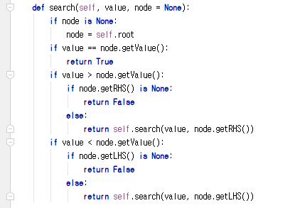
Search Operation of Binary Search Tree
Search operation
Retrieve the current node value
If the value is equal to the value to search
Return TRUE
If the value is smaller than the value to search
If there is a node in the right hand-side (RHS), then move to the RHS node (Recursion)
If there is no node in RHS, return FALSE
If the value is larger than the value to search
If there is a node in the left hand-side (LHS), then move to the LHS node (Recursion)
If there is no node in LHS, return FALSE
Find 4 in the BST
3
2
5
0
4
7
Notes:
We’ve sorted out how to insert in a binary search tree.
A search operation is not different from what we’ve learned when we studied how to insert.
Let’s see how to carry out the search operation.
Suppose that we are searching for a numeric value 4 in this binary search tree.
As we have a reference, the binary search tree, we conduct a search operation for 4.
As we have a search operation in the tree, we placed 4 into the entrance value.
As a search tree has only the one reference for the root, we have no alternative but to determine if the root is 4.
If the root is 4, we could be able to finish by returning True. However, as 4 is situated at the lower level, we’ve
got to employ a recursion.
First off, 4 is stored in a tree structure. It is a binary search tree, which we know the rule that: if the value of the
node below is smaller than the current node, it will go to the LHS; and If it is larger than others, it will go to the
RHS. As 4 is larger than 3, we can be sure that it is in the RHS.
There is no need for us to search in this area.
As we have conducted an ‘insert’ operation in accordance with the rule, we do not need to search the LHS.
Then we shall locate 5 after finding 3.
However, we cannot adopt the same approach of 4 to 5.
And we have no idea which value is present in the node below, our search would be longer.
The value of node in the LHS should be smaller than 5 and the RHS is occupied with a larger value. And 4 is
smaller than 5, we do not search in the RHS.
So, we could limit our search to this area only and find 4 to return True.
In a linked list, we had to keep on chasing the chain and we have to visit all the N chains to confirm if our target
was present.
However, we need to look not for all the N nodes but for as much as the height or the maximum depth of the
tree.
Therefore, as we entered the values according to rules, which helps narrowing down the area for search.
Eventually, the limited search area makes it more efficient than a linked list.
If the current value matches to the search value, we can just return True. If it is not identical with no child, we
can return False.
In the presence of child, however, we may further carry out a search in accordance with the following rules.
First, if it is smaller than the present value, two options are available.
The first case is when there is a child in the RHS: we can conduct a search by recursively advancing to the node
of the RHS.
The second case that the RHS has no child: we can search for a smaller value than the one in the current node
and as there is no target value, we can just return False.
Similarly, if the target value is larger than the current value, we have to look at the LHS.
If the LHS has a child, we use a recursion to move on to the LHS for search.
Conversely, if the LHS has no child, meaning that there is no target value, we can just return False.
Now, let’s figure out how to implement such an idea.
If a search is to be recursive, it is about an escape routine and a repeating problem, but it also has a part to call in
a diminished scale.
This is a default part, signifying if a node is empty, start from the root.
This part indicates an escape routine. If the value and the value of the node in search are identical, True should
be returned.
Next, we have to review the statement where a recursion occurs.
If the target value for search is larger than the current value, we have to check the RHS. Thus, a search occurs in
a reduced sale in the RHS.
Likewise, if the current value is smaller than the searching value, we should conduct the search in the LHS.
Finally, if there is no more path to descend for search, we should return False.

Slide 7
Delete Operation of Binary Search Tree (1)
First, you need to find the node to delete through recursions
Three deletion cases
Case 1: deleting a node with no children
Just remove the node by modifying its parent
Case 2: deleting a node with one child
Replace the node with the child
Case 3: deleting a node with two children
Find either
A maximum in the LHS or A minimum in the RHS
Substitute the node to delete with the found value
Delete the found node in the LHS or the RHS
3
2
5
0
4
7
Case 1: Just Remove ‘0’
3
2
5
0
4
7
Case 2: Replace ‘2’ with ‘0’
Notes:
We’ve covered search and insert operations, and finally, we will learn about ‘delete.’
Deletion is somewhat complicated operation in a tree.
Because it tends to leave some consequences after executing ‘delete.’
Suppose that we employ ‘delete’ in the tree structure.
It actually means removing a node.
Each circle here forms a node.
For instance, there is some occasion that we remove 0, 2 or 3.
But they constitute all the different cases.
For 0 means no child.
In this case, therefore, it does not matter if we just remove 0.
If we remove 0, we will lose the access to 0 by preventing the referencing from 2.
Let’s think about removing 2.
2 is at present one child.
It is okay to lose 2 not 0.
Then we have to figure out how to leave 0 in the absence of 2, having a significant impact on the tree.
Thus, deleting the number 2, or one child and 0 with no child differ significantly from each other.
Next, let’s consider the case of deleting the node containing 3.
3 has two children.
If we are to remove the numeric value 2, we may just consider 0. To delete 3, however, we have to consider both
nodes.
Hence, we have to think about the consequence of deleting 3 from the tree and how to leave 2 and 5. It’s quite
different from removing 2.
Thus, we have 3 deletion scenarios in total.
The 1st case is to delete 0 as the case of no children.
As explicated before, it is not complex.
We have to move to the parent node of the target node to cut off its reference.
The way to sever the reference is to put a garbage value or ‘None’ into the reference.
So, removing 0 from the tree is the easiest.
Just like eliminating the last node of a linked list, we can cut the connection of the reference and reestablish the
connection, but for this case, we do not even need to reestablish the connection.
The 2nd case is classified as a one-child situation, which is a bit more difficult.
It is identical with the situation of removing 2 from the tree.
In fact, we can replace 2 with what’s below.
As there is no other node, both 2 and 0 moved the level up through the LHS from the perspective of 3. So, if 0 is
ascended, the rule that it is smaller than 3 is still valid.
Thus, we may remove 2 from the tree and replace it with 0 right away,
Unlike the case of the node with no child where we cut off the connection and leave None in the node, for 3,
when the reference pointing to the LHS is free, it will be connected to the remaining only child.
It will allow us to keep the rule while eliminating the way to reference 2.
While 2 is currently pointing to 0, there is no node that points at 2 so that it is the same with the absence.
Such a node will be eliminated by a garbage collector.
Thus, if a node has one child, we should not just cut the connection but also reestablishing the connection to the
only child.
Finally, the case 3 involves deleting a node of two children.
As it’s complicated, we will examine it closely in the next slide.

Slide 8
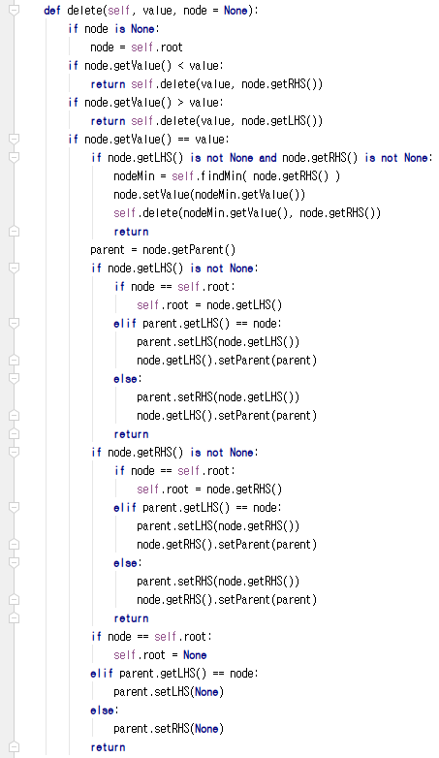
Delete Operation of Binary Search Tree (2)
4
2
2
5
0
5
0
7
4
7
Delete ‘4’ in RHS
Delete ‘2’ in LHS
4
2
2
5
2
5
0
4
7
3
0
4
7
Replace ‘3’ with ‘4’
Replace ‘3’ with ‘2’
2
5
0
4
7
Case 3: Replace ‘3’ with ‘X’
Notes:
This is a situation where we should eliminate the node of two children such as 3.
There are two different solutions to delete 3 from the tree.
The most fundamental concept for the solution is to add another node.
If we place 2 or 5 up in the level as the added node, it will lead to a trouble.
It doesn’t matter if we put 2 upwards. But if it is 5, the numeric values of 0,2 and 5 move up, leaving 4 and 7.
If we add 7 and 4 here, it is against the rule.
The opposite case is also against 5.
However, putting 5 up would not solve the problem.
2 will result in the same dilemma.
So, we cannot apply the solution of raising the right sub-node.
We’ve got to understand the characteristics of the value first.
This value is at the just middle of the LHS and RHS.
5 is not located in the middle, rather it is 4 that is closer to the center.
From the perspective of the RHS of 3, 4 or the LHS of 5 is more similar than 5
If the numeric value is present in both the RHS and LHS, as in the case of 3, the minimum of the RHS and the
maximum of LHS are the closest to the center.
In other words, there are two types of solutions.
We can decide between the two solutions: whether to find the max. of the LHS or the min. of the RHS.
This has been opted for the minimum of the RHS as a solution.
If we look for the minimum of the RHS with the tree, we can find a smaller value by starting from the node
containing 3 that is to be deleted then move on to the RHS and follow down to the LHS.
To get the minimum node, we shall search for a node until there is no more LHS.
The value obtained here is 4.
Then let’s overlap the numeric value 4 onto it.
We do not move the reference of a node but just copy the value of the node.
Doing so allows us to transfer values upward without having to modify the node structure.
Now we have to delete the existing value, 4.
It is guaranteed that 4 has no child or one child.
Because, there is no more nodes after coming down though the LHS, it would have no LHS(child) or only RHS
(one child).
It could never have two children for that means it has the LHS further below so that it should be excluded from
the selection.
Therefore, it will only have one child or no child and then we may apply what we’ve learned to delete the node.
So, it will make a tree like this.
Similarly, it is the same deletion operation with the other side.
It is the process of searching for the maximum of the LHS and substitute it.
Above all, we start by going to the LHS.
Then we will meet 2.
To find out the max, we just have to keep on moving down through RHS.
Down below at the value 2, we already run out of the RHS.
That means that 2 is maximum in this subtree.
Hence, we have to copy the value 2.
The node containing 2 is a one child type.
Two children are not possible at all.
If so, it has to move further on the RHS to be the max.
Thus, we will cut the connection with the node containing 2 and connect the released reference with 0.
The result is the tree like this.
Therefore, the deletion of the node with two children could have different results.
The underlying principle is identical.
When the RHS is chosen, it is necessary to find the min., and if the LHS is selected, max. should be find out.
Then subtitle the variable of the target before deleting the node.
There is a code related to deletion.
As I post all the codes later, let’s briefly touch upon the code.
Let’s look for the LHS and RHS of a node
If they are found to have value other than garbage values, in this case, it is about locating the minimum of RHS.
After locating the minimum, the process involves in copying the value by means of setValue, then recursively
search the target value in RHS before deleting the value.
If it is not a node with two children, we can search for the value at the lower level.
If the LHS is not null and has one child we can obtain the solution in this way.
In this case, as the LHS is not null, we need to connect my parent to the parent of the node in the LHS and the
LHS of the parent with my LHS.
The same thing can be done for the RHS.
If there is no child, we can just sever the link.
It should be the connection pointing to the parent.
That’s how we can implement ‘delete.’

Slide 9
Tree Traversing
Tree
Complicated than a list
Multiple ways to show the entire dataset
If it were a list
Just show the values from the beginning to the end
Since this is a BST
You have to choose what to show at a time
The value in LHS
The value in RHS
The value that you have
Hence there are multiple traversing approaches
Inserting 3, 2, 0, 5, 7, 4, 6, 1, 9, 8
LHS
RHS
Level 1
3
Level 2
2
5
Level 3
0
4
7
Level 4
1
6
9
Level 5
8
Notes:
The last operation we are going to study is traversing.
We haven’t heard about the term, traversing
You are familiar with data structure such as linked list, stack and queue and they are all linearly connected.
For instance, a linked list is connected in this manner.
If you mark all the values here, you can print out every value from head to tail until it hits the target.
Assume that, however, there are various values contained in a tree.
If we are to print all these values, which order should we follow?
Do we have to print 3 first followed by 2 and 5?
It can be printed out according to different levels.
However, some might argue that it is imperative to print the RHSs after printing out the LHSs.
We can also comply with some rules to print.
Then we might wonder how to print out the LHS if the LHSs prior to 3 are all printed out? And In which order
the RHSs should be printed?
Thus, we have to define how to solve the problem.
While it is possible for a linked list to print out every variable from the head to tail in the universally accepted manner, a tree has so many approaches such as printing out by levels, ‘depth first’ , which figures out the LHS depth first, print 3 before printing RHS depths, and ‘breath first’ that its traversing operation is complicated.
It is possible to have multiple ways.
It has a range of options over when to print the LHS, RHS, and the currently obtained values, among others.
Let’s look over the traversing operation.

Slide 10
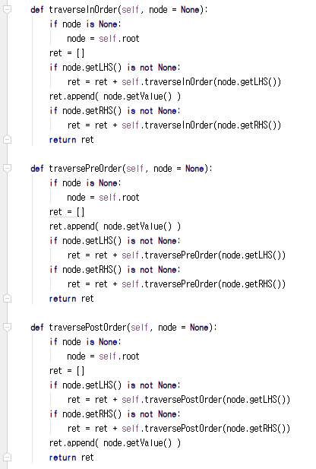
Depth First Traverse
Pre-order traverse
Order: Current, LHS, RHS in Recursion
3, 2, 0, 1, 5, 4, 7, 6, 9, 8
In-order traverse
Order: LHS, Current, RHS in Recursion
0, 1, 2, 3, 4, 5, 6, 7, 8, 9
Post-order traverse
Order: LHS, RHS, Current in Recursion
1, 0, 2, 4, 6, 8, 9, 7, 5, 3
3
2
5
0
4
7
1
6
9
8
Notes:
What we are going to cover is a depth first traverse.
A depth first traverse is a traversing approach that figures out a problem of whether to start with the LHS or
RHS in a recursion technique.
Basically, the order of the LHS and RHS is obvious.
As the LHS has a smaller value, it is common to opt for returning the LHS before RHS between the two.
However, it would be controversial to determine where to return the current value that points at it.
Considering that the values contain both the LHS and RHS, it could be values that should be denoted first.
Or some might argue that the value should be put in-between the LHS and RHS, based on their sizes: for LHS is
the smallest, followed by value and RHS.
Or there would be others who would suggest to put in the very last contrary to the first one.
In sum, there are three methods.
Depending on when to return a value, therefore, there are 3 different ways of depth first traverses.
The 1st is a pre-order traverse.
So, the 1st option is to execute ‘return’ before a traverse occurs.
The 2nd is an in-order traverse.
This 2nd option is to carry out ‘return’ in-between the LHS and RHS.
The last one, the post-order traverse is the 3rd option that returns values after the return of the LHS and RHS.
A ‘pre’ involves in recursively executing with the current value, the LHS and RHS.
An ‘In-order’ recursively conducts the LHS, current and RHS while a ‘post-order” returns the LHS, RHS, and
current.
Let’s get to the pre-order traverse first.
The pre-order begins with 3.
As it is the pre-order traverse, it will return 3 first.
Then it will handle the LHSs before moving on to the RHS.
This is the LHS and that is the RHS.
As it recursively traverses in 2, it would be considered as the same problem in the sub tree.
Thus, we will return 2 first.
After handling the LHS, there is no RHS.
To treat the LHS, it descends to 0 to return 0 first. As there is no LHS, 1, which is the RHS will be the current
value.
As it moves up to find there is no RHS for 2, and terminates.
This is how the return on the LHS of 3 is completed.
So, it will go down to the RHS of 3.
So, it would be the matter of a small scale, 5 will be the current value and returned.
Then it will go down to the LHS to return 4.
4 has no LHS and RHS.
Thus, it will recursively return and descend to the small scale of the RHS of 5.
Thus, it will result in 7, followed by the LHS or 6, then move on to the RHS to return 9 and 8.
This is how a pre-order traversing is progressed.
Next is the implementation of the pre-order traversing in codes.
As you see here, it defines the list on return, and append the value of the current value with a getValue method.
Then it conducts a pre-order traverse for the LHS of a small-scale matter with the identical algorithm to append
its return value.
Then, the RHS is made into a small-scale problem to apply the same algorithm before appending the return
value obtained.
This is a pre-order traversing.
Now we will do the same with an in-order traversing.
And in-order traversing relies on a method that completes the LHSs, then moves to the current value and RHSs.
First, we get 3 and before returning 3, this approach returns the LHS and after that moves on to 3.
So, after returning all the LHSs, it returns 3 followed by the RHSs.
As for the LHS, though the target is 2, it won’t return it right away. Instead, it will return the LHS first then go
to 2 and RHSs for return.
To do so, it is necessary to check the LHS of 2.
The LHS of 2 is 0.
As there is no LHS for 0, we would return 0 then the RHS of 0 or 1.
As we’ve completed the LHSs of 2, we now return 2.
As there is no RHS for 2, the RHS is left empty and gets 0, 1, 2 and 3.
Then we shall return 3 and tackle the RHS of 3.
After that, we would like to take care of 5.
Before treating 5, the LHS, or 4 is returned so as the current value, 5.
To handle the RHS of 5, we have to return the LHS of 7 or 6 prior to 7. Then we shall return 7 and before handle
the RHS of 7, or 9, we have to return its LHS or 8 then return 9.
So finally, we have the print of 0, 1, 2, 3, 4, 5, 6, 7, 8, 9.
An in-order traversing has the same result with that of the sorting.
The in-order traversing is implemented here.
Though it uses the same method for a recursive call, when it appends the current value is different.
While the current value was appended first in the pre-order traversing, appending it becomes the 2nd task in the
in-order traversing.
In the post-order traversing the current value will be appended after completing returns for the LHS and RHS.
Let’s do the exercise.
The current value 3 should return the LHS and RHS first.
It will turn into 2 after descending to the LHS, and again into 0 by moving down on the LHS.
Prior to printing 0, there is no LHS. And as we return the RHS first, 1 will be returned, followed by 0.
Then as there is no RHS for 2, it will automatically result in 2.
Before returning 3, we have to complete the LHS and return the RHS first.
It will go down to the RHS or 5 and further down to 4, which is the LHS of 5.
As there is no LHS or RHS for 4, 4 will be returned right away.
Thus, it will complete the LHS of 5 and now we should handle the RHS of 5.
As we follow down of the RHS of 5, it becomes 7.
As we descend to the LHS of 7, or 6 and there are no LHS and RHS for 6, 6 will be returned.
Then we go down to the RHS of 7 to return the LHS of 9, or 8 and return 9. Then it will complete the LHS and
RHS of 7 to return 7.
As both LHS and RHS of 5 have ended, 5 will be returned before returning 3.
In the end, it will print out 1, 0, 2, 4, 6, 8, 9, 7, 5, 3.
The post-order will be implemented here in the form of codes.
First, both LHS and RHS are appended and finally, the current values will be returned.
These three methods fall into the category of a depth first traverse.
There are three different methods of a depth first traverse including in-order, pre-order and post-order.

Slide 11
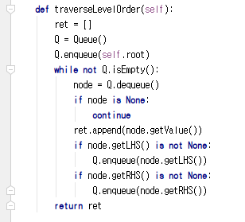
Breadth First Traverse
Queue-based level-order traverse
3, 2, 5, 0, 4, 7, 1, 6, 9, 8
Enqueue the root
While until queue is empty
Current = Dequeue one element
Print current
If Current’s LHS exist
Enqueue current.LHS
If Current’s RHS exist
Enqueue current.RHS
3
2
5
0
4
7
1
6
9
Current | Queue
 | 3
3 | 2, 5
2 | 5, 0
5 | 0, 4, 7
0 | 4, 7, 1
4 | 7, 1
7 | 1, 6, 9
1 | 6, 9
6 | 9
9 | 8
8
8
Notes:
This time, let’s explore a breath first traversing.
As for a depth first traversing, it is based on recursion, which includes a stack frame.
Now, we will conduct a traversing by means of a queue.
So, it will be a queue-based level-order traverse.
Suppose that there is a tree structure such as this.
In this method, we would first enqueue the root.
Then we will adopt a while loop so as to iterate the queue to empty out.
As there is the root inside, it means that it will perform at least one iteration
We dequeue the 1st element from the queue.
Here the 1st element refers to the root.
Then the current value will be printed out.
Next, if there is the LHS for the root, enqueue the node in the queue.
If there is another RHS, this node should be enqueued in a queue.
It is a situation where a single numeric value, 3 and enqueue two numeric values, 2 and 5.
Then we will apply a while loop once again.
This particular method is called breadth first search, which aims at the level-order traversing.
This approach will be employed when a traverse is executed level by level.
the method is not recursively break down to sub-problems, but print each item one by one using a queue, rather
than recursion.
Let’s review the process with this tree.
First, we enqueue the root, 3, in accordance with the rule.
After enqueueing 3, we perform a while loop.
At present, there is only one numeric value, 3, in the queue so that 3 is dequeued.
According to the rule that if there are the LHS and RHS for a numeric value, enqueue, so 2 and 5 are enqueued.
The 1st while loop is completed.
The 1st element of it, 2, is dequeued and there is still 5.
As 2 is dequeued to be the current value, 0 is enqueued for the presence of the LHS of 2.
As there is no RHS of 2, it will end.
Then the next first one, 5 is dequeued.
As 5 has both LHS and RHS, we will enqueue 4 and 7.
Then we dequeue one numeric value.
4 and 7 descend as they are, and there is no LHS for 0 so that its RHS, 1, is enqueued.
Then we dequeue the numerical value 4 as it takes the foremost place.
There is no LHS or RHS for 4, there is none to enqueue.
As a result, 7 and 1 move a level down.
The front value, 7, is dequeued.
We enqueue both LHS and RHS, or 6 and 9.
Next, 1 is dequeued.
As there is no LHS and RHS for 1, we have nothing to be enqueued, thereby getting 6 and 9 down.
As 6 has no child, there is nothing to be enqueued.
We enqueue the child of 9, or 8 and subsequently 8 is enqueued.
As there is no child of 8 found, the list is empty and the while loop ends.
Eventually the printout result will be 3, 2, 5, 0, 4, 7, 1, 6, 7, 8, which clearly indicates that it is printed in a level
order.
The below is the implementation of what we have covered in codes.
First, we create a queue and enqueue the root in the queue.
If the queen is not empty, it will go down to be in the loop.
First one item is dequeued and the LHS and RHS are other than null, they are enqueued in the queue.
This very iteration is called breadth first traversing.
Unlike a recursion, it navigates through a tree structure by means of a queue.

Slide 12
Offline Class Plan

Slide 13

Party Classification
Political party
Voting record
https://archive.ics.uci.edu/ml/datasets/congressional+voting+records
Attribute
Class
Democrat or Republican
Features (? means no record)
handicapped-infants: 2 (y,n)
water-project-cost-sharing: 2 (y,n)
adoption-of-the-budget-resolution: 2 (y,n)
physician-fee-freeze: 2 (y,n)
el-salvador-aid: 2 (y,n)
religious-groups-in-schools: 2 (y,n)
anti-satellite-test-ban: 2 (y,n)
aid-to-nicaraguan-contras: 2 (y,n)
mx-missile: 2 (y,n)
immigration: 2 (y,n)
synfuels-corporation-cutback: 2 (y,n)
education-spending: 2 (y,n)
superfund-right-to-sue: 2 (y,n)
crime: 2 (y,n)
duty-free-exports: 2 (y,n)
export-administration-act-south-africa: 2 (y,n)
Can we classify the allegiance to the political party with the voting record? And How?

Slide 14
Sky | Temp | Humid | Wind | Water | Forecst | EnjoySpt
Sunny | Warm | Normal | Strong | Warm | Same | Yes
Sunny | Warm | High | Strong | Warm | Same | Yes
Rainy | Cold | High | Strong | Warm | Change | No
Sunny | Warm | High | Strong | Cool | Change | Yes
Decision Tree
We need a better learning method
We need to have more robust methods given the noises
We need to have more concise presentations of the hypotheses
One alternative is a decision tree
<Sunny, ?,?,?,?,?>
Sky
Rainy
Sunny
No
Yes
Sky
<Sunny, Warm, ?, Strong, ?, ?>
Rainy
Sunny
No
Temp
Only one potential decision tree corresponding to the hypothesis
Cold
Warm
No
Wind
Light
Strong
Yes
No

Slide 15

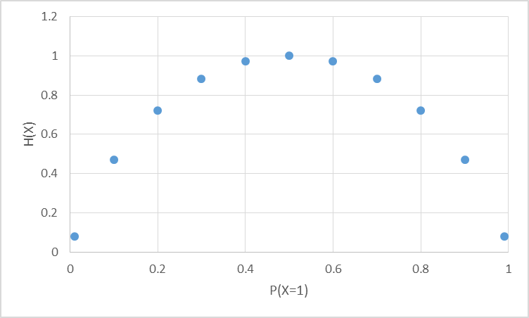
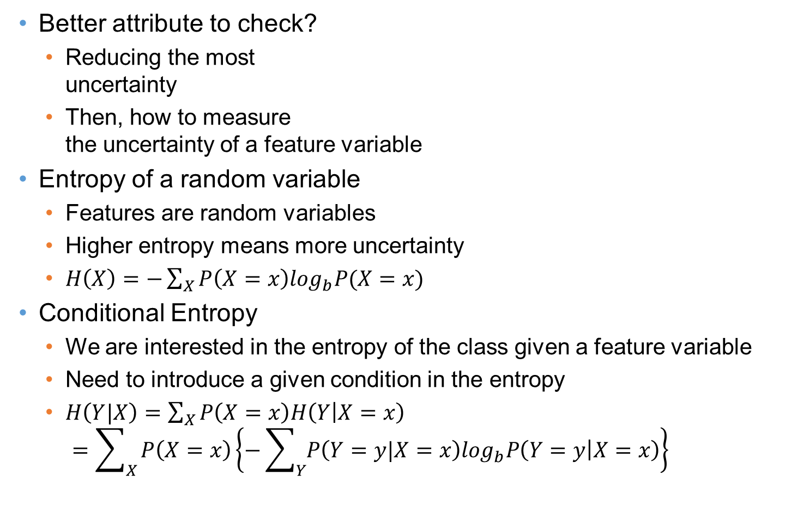
Entropy
Most random case
Better attribute to check?
Reducing the most uncertainty
Then, how to measure the uncertainty of a feature variable
Entropy of a random variable
Features are random variables
Higher entropy means more uncertainty
$H\left(X\right)=−\sum_{X}{P\left(X=x\right)\log_{b}P(X=x)}$
Conditional Entropy
We are interested in the entropy of the class given a feature variable
Need to introduce a given condition in the entropy
$H\left(Y|X\right)=\sum_{X}{P\left(X=x\right)H\left(Y | X=x\right)}$ $=\sum_{X}{P\left(X=x\right)\left\{−\sum_{Y}{P\left(Y=y|X=x\right)\log_{b}P\left(Y=y | X=x\right)}\right\}}$
All instances are X=0
All instances are X=1

Slide 16
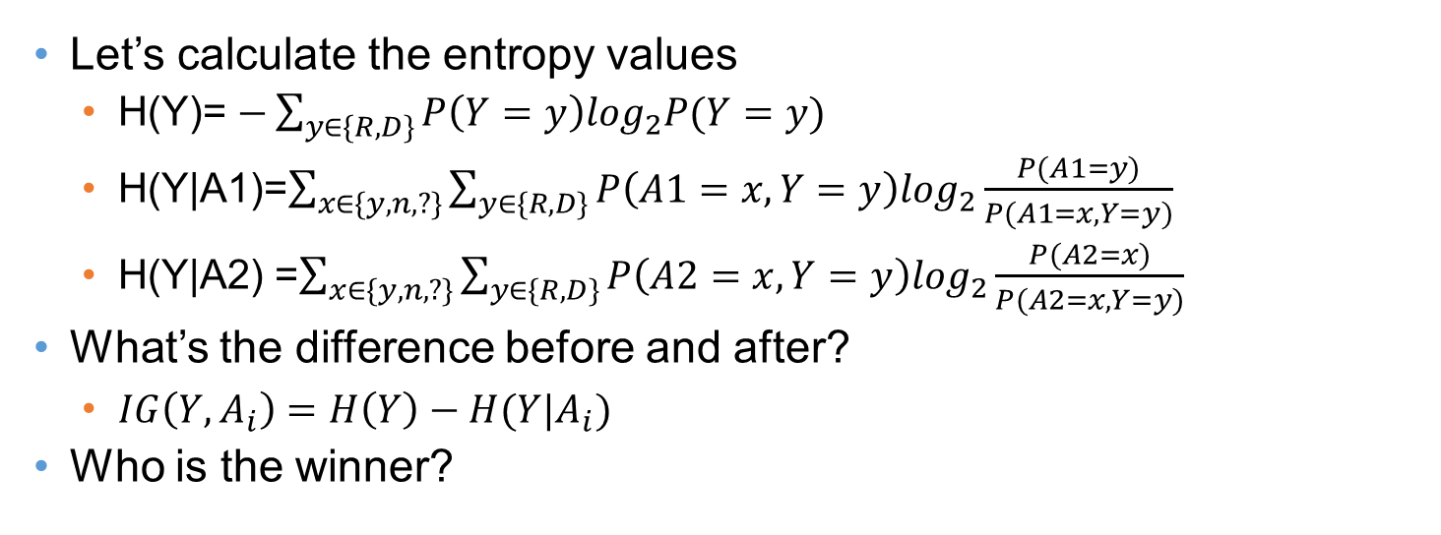
Information Gain
Entropy Before Decision Node
A1 (168R,267D)
A2 (168R,267D)
y
n
?
y
n
?
31R,156D
134R,102D
3R,9D
75R,120D
73R,119D
20R,28D
Entropy After Decision Node A1
Entropy After Decision Node A9
Let’s calculate the entropy values
H(Y)= $−\sum_{y∈\{R,D\}}{P\left(Y=y\right)\log_{2}P(Y=y)}$
H(Y|A1)=$\sum_{x∈\{y,n,?\}}{\sum_{y∈\{R,D\}}{P\left(A1=x,Y=y\right)\log_{2}\frac{P(A1=y)}{P(A1=x,Y=y)}}}$
H(Y|A2) =$\sum_{x∈\{y,n,?\}}{\sum_{y∈\{R,D\}}{P\left(A2=x,Y=y\right)\log_{2}\frac{P(A2=x)}{P(A2=x,Y=y)}}}$
What’s the difference before and after?
$IG\left(Y,A_{i}\right)=H\left(Y\right)−H(Y|A_{i})$
Who is the winner?

Slide 17
Top-Down Induction Algorithm
Many, many variations in learning a decision tree
ID3, C4.5 CART….
One example: ID3 algorithm
ID3 algorithm
Create an initial open node
Put instances in the initial node
Repeat until no open node
Select an open node to split
Select a best variable to split
For values of the selected variable
Sort instances with the value of the selected variable
Put the sorted items under the branch of the value of the variable
If the sorted items are all in one class
Close the leaf node of the branch
Classify the majority cases in the leaf
Split the node until there is only type
A1 (168R,267D)
y
n
?
31R,156D
134R,102D
3R,9D
A1 (168R,267D)
y
n
?
A2 (31R,156D)
134R,102D
3R,9D
y
n
?
16R,72D
11R,71D
4R,13D

Slide 18
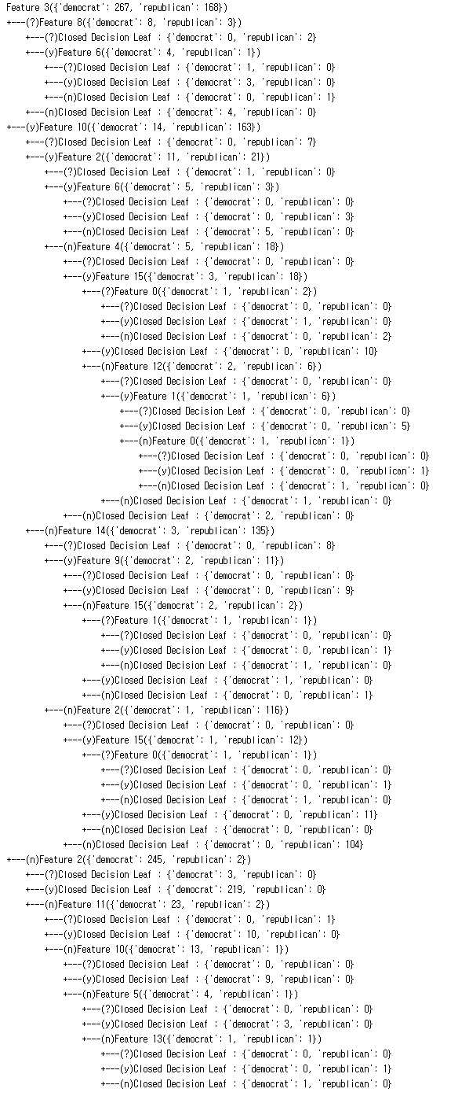
If you want more…

Slide 19
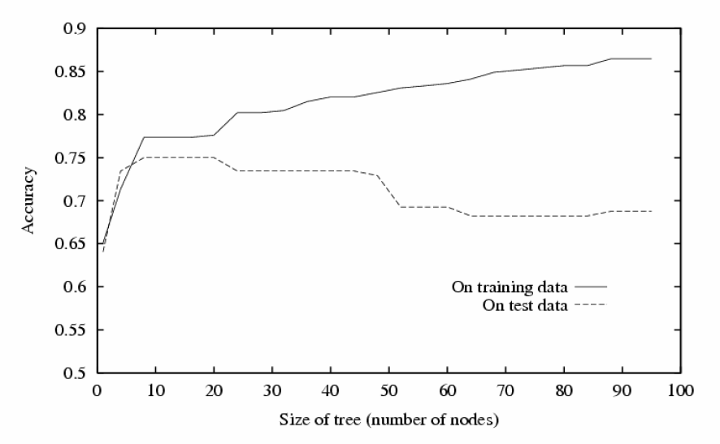
Problem of Decision Tree
We did better in the given dataset!
Only in the given experience, a.k.a. Training dataset
What if we deploy the created decision tree in the field?
World has so much noise and inconsistencies.
The training dataset will not be a perfect sample of the real world
Noise
Inconsistencies
Typical result of decision tree
Should have stopped here!
Knowing when to stop is a pretty difficult task. How to do it?
- Pruning by divided dataset?
- Path length penalty?

Slide 20
To-Dos
We are going to complete a decision tree
Use recursion to perform ID3 algorithm
Follow the tree structure to classify an instance
To-dos
Read the code in “voterecord.py” and “decisiontreenode.py”
To-do 1: complete “performID3”
How to start the recursion?
What is the condition of no-split?
How to perform the recursion?
To-do 2: complete “classify”
What is the decision node to start?
How to find the next node to follow?
How to recognize the node to stop?

Slide 21
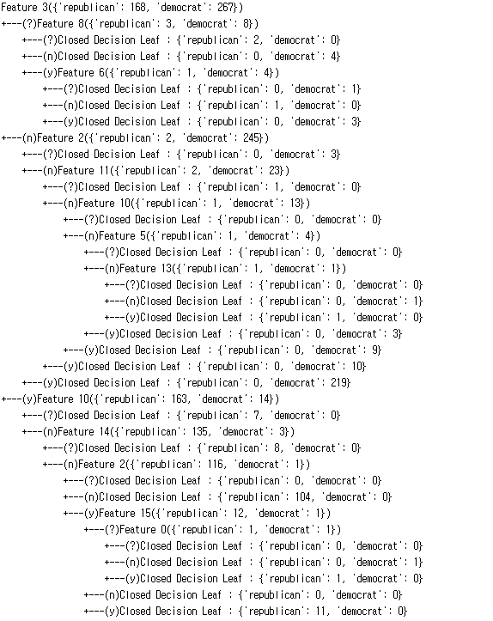
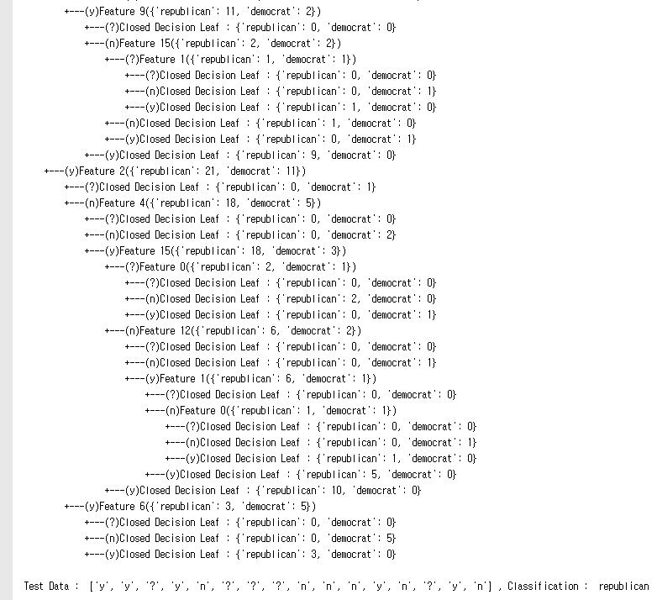
Execution Result
When you complete the codes, you are expected to see the below results.
Execute ‘decisiontree.py’

